Slide 1
US Sharps Injuries:
Prevention Strategies to Halt the Rise
Terry Grimmond, FASM, BAgrSc, GrDpAdEd
Director, Grimmond & Assoc. Microbiology Consultancy
terry@terrygrimmond.com
APIC IL, Oct 25, 2018 v3

Slide 2
Thank you!
APIC IL
Daniels Health
You

Slide 3
Learning Objectives
Discuss US sharps injury trends, incl 2017 EXPO-STOP results
Outline why SI have not decreased as expected
Discuss 5 successful strategies used by low-incidence hospitals

Slide 4
SI Trends since 2000
NSPA
EPINet
MADPH
EXPO-STOP
SI
Per
100
ADC
-38%
SI per
100
Occ
Beds
CDC 2001
“Zero in
5 years”
Massachusetts DPH. SI among HCW in MA. 2002-15. http://www.mass.gov/eohhs/gov/departments/dph/programs/community-health/ohsp/sharps/data-and-statistics.html
International Safety Center. EPINet Reports 2000 – 2015. https://internationalsafetycenter.org/exposure-reports/.
Grimmond T & Good L. Exposure Survey of Trends in Occupational Practice (EXPO-S.T.O.P.) 2015. Am J Infect Control 2017; 45(11): 1218–23

Slide 5
“Occupied Beds” is poor workload Indicator
SI Trends since 2000
EPINet
MADPH
EXPO-STOP
SI
Per
100
ADC
SI per
100
Occ
Beds
Massachusetts DPH. SI among HCW in MA. 2002-15. http://www.mass.gov/eohhs/gov/departments/dph/programs/community-health/ohsp/sharps/data-and-statistics.html
International Safety Center. EPINet Reports 2000 – 2015. https://internationalsafetycenter.org/exposure-reports/.
Grimmond T & Good L. Exposure Survey of Trends in Occupational Practice (EXPO-S.T.O.P.) 2015. Am J Infect Control 2017; 45(11): 1218–23

Slide 6
Sharps Injury Rates per FTE (good workload indicator)
EPINet
EXPO-STOP
Why are SI persisting?
Why now increasing?
SI
per
100
FTE
-7%
In 16 years!
Notes:
[TERRY]
We are still concerned as the rate is still rising. Remember, we have a higher % of Teaching Hospitals than the national proportion (20%) – so our EXPO-STOP rate may be higher than the true national rate.
But we cannot be complacent!
Remember, there are not 3 Bloodborne Pathogens, there are 60!
(CLICK)

Slide 7
EXPO-STOP SI Rates
SI Rates in hospitals | 2017
SI/100 FTE | 2.5
Nurse SI/100 Nurse FTE | 2.7
Who gets stuck? | 2011 | 2016 | 2017
Nurses | - | 36% | 38%
Doctors | - | 36% | 33%
Surgical Procedures | 37% | 39% | 40%
Nurse SI steady; Drs SI slightly down - why?
OR SI % rising (20 years ago, OR was 20-25% of Total SI);
OR is the challenge (sutures, passing sharps)

Slide 8
Why have SI not decreased as expected?
SI fallen off radar (“No data, No problem, No Action”)
OSHA - SI hardly registers (SI “low”– no “days off”)
“But HIV & HCV are treatable; HBV is excellent vaccine” (2.2% I,B,C)
SED effectiveness (“But we comply with OSHA” )
Lack Competency training
Competition with HAI
SED use (Always? Activated?)

Slide 9
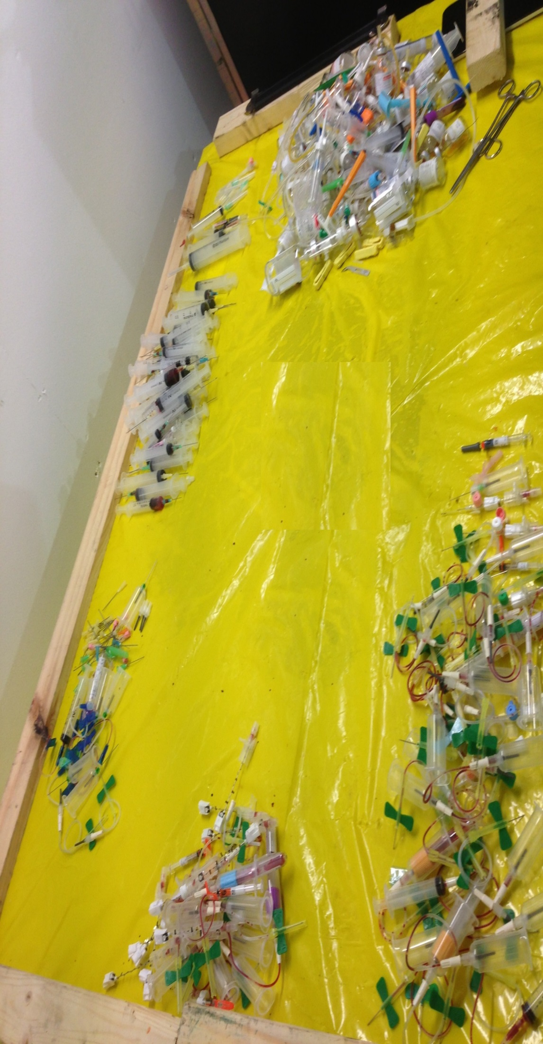
“Use and activation of safety engineered sharps devices in a sample of 5 Florida healthcare facilities”
Grimmond T. J Assoc Occup Hlth Prof 2014;34(1):13-15
Needles
Capped needles
Syringe-needles
Activated SED
Other sharps
Non-activated SED

Slide 10
Major Audit Study: Results (West, NE regions)
11 hospitals
780 L sharps
3,932 HBN
Not SED = 17% (3%-48%)
SED not activated = 6% (1% - 18%)
Discarded “sharp” or capped = 17% (4%-50%)
Not all sharps containers are equal – use the safest
EPINet 2017: Sharps injuries
From non SED = 62%
From SED during or after activation = 49%

Slide 11
So, Currently in US…
>300,000 HCW sustain SI annually – >800 every day!
60 Pathogens can be transmitted by SI
New BBP can emerge (e.g. Ebola, Zika)
SI cause large emotional impact in many HCW
Renewed focus needed

Slide 12
SI Reduction Strategies in top 10 hospitals
(Incidence rates were 70% below U.S. average)
Leadership Support
Education & Training
Communication
Investigation
Engagement
Good L & Grimmond T. Proven Strategies to Prevent Bloodborne Pathogen Exposure in
EXPO-S.T.O.P. Hospitals. J Assoc Occ Hlth Prof 2017:36(1);1-5.
Notes:
[LINDA]
Many useful tips have been identified over the years by interviewing Employee Health personnel at these and other “Exposure Safe” hospitals. We go into more detail in the AOHP Journal– this morning I want to share a few favorites
EDUCATION: Don’t assume clinicians new to your facility – including physicians and Interns and Residents--are familiar with your particular safety-engineered devices. “Exposure Safe” hospitals require all new clinicians demonstrate competency on all new devices.
COMMUNICATION: “Exposure Safe” facilities align their initiatives and reporting with their organization’s terminology and methodology “style” -- this could be “Lean”, “Standard Work”, A-3. This allows your exposure prevention approach and success to stand next to all others --Much more likely to be recognized and appreciated in the annual list of “success stories” – than a ‘one-off’ stand alone campaign.
INVESTIGATION: “Exposure Safe” facilities “Drill Down’’– conducting a through root-cause analysis on every incident – and these investigations involve senior leadership
ENGAGEMENT: “Exposure Safe” facilities hold both the front-line care giver and the management responsible for assuring safety. One of my favorite research studies is was by Carol Gershon demonstrating how “Safety Climate” flows across all areas–
“Employees who perceived strong senior leadership support for safety and who received high levels of safety-related feedback and training were half as likely to experience blood or body fluid exposure incidents.”

Slide 13
Leadership Support
Strong commitment from the top
Backing strategies with resources
Firm commitment on tough policies/requirements
  E.g. Exclude non-SED. (Need apply in writing to Safety C’tee)
Welcome frontline-staff as partners in safety
Notes:
[LINDA]
Many useful tips have been identified over the years by interviewing Employee Health personnel at these and other “Exposure Safe” hospitals. We go into more detail in the AOHP Journal– this morning I want to share a few favorites
EDUCATION: Don’t assume clinicians new to your facility – including physicians and Interns and Residents--are familiar with your particular safety-engineered devices. “Exposure Safe” hospitals require all new clinicians demonstrate competency on all new devices.
COMMUNICATION: “Exposure Safe” facilities align their initiatives and reporting with their organization’s terminology and methodology “style” -- this could be “Lean”, “Standard Work”, A-3. This allows your exposure prevention approach and success to stand next to all others --Much more likely to be recognized and appreciated in the annual list of “success stories” – than a ‘one-off’ stand alone campaign.
INVESTIGATION: “Exposure Safe” facilities “Drill Down’’– conducting a through root-cause analysis on every incident – and these investigations involve senior leadership
ENGAGEMENT: “Exposure Safe” facilities hold both the front-line care giver and the management responsible for assuring safety. One of my favorite research studies is was by Carol Gershon demonstrating how “Safety Climate” flows across all areas–
“Employees who perceived strong senior leadership support for safety and who received high levels of safety-related feedback and training were half as likely to experience blood or body fluid exposure incidents.”

Slide 14
Education and Training
Cannot assume new staff “know” your policies, rules, SED
The need demonstrate competency with relevant SED – incl Drs.
Sign-off on “completion & understanding”: e.g. policies, practices,
  Reporting procedures, unauthorized SED use.
Return for training if: SI, new SED, every 2 years
Simulation lab; All staff/shifts; use vendors
Notes:
[LINDA]
Many useful tips have been identified over the years by interviewing Employee Health personnel at these and other “Exposure Safe” hospitals. We go into more detail in the AOHP Journal– this morning I want to share a few favorites
EDUCATION: Don’t assume clinicians new to your facility – including physicians and Interns and Residents--are familiar with your particular safety-engineered devices. “Exposure Safe” hospitals require all new clinicians demonstrate competency on all new devices.
COMMUNICATION: “Exposure Safe” facilities align their initiatives and reporting with their organization’s terminology and methodology “style” -- this could be “Lean”, “Standard Work”, A-3. This allows your exposure prevention approach and success to stand next to all others --Much more likely to be recognized and appreciated in the annual list of “success stories” – than a ‘one-off’ stand alone campaign.
INVESTIGATION: “Exposure Safe” facilities “Drill Down’’– conducting a through root-cause analysis on every incident – and these investigations involve senior leadership
ENGAGEMENT: “Exposure Safe” facilities hold both the front-line care giver and the management responsible for assuring safety. One of my favorite research studies is was by Carol Gershon demonstrating how “Safety Climate” flows across all areas–
“Employees who perceived strong senior leadership support for safety and who received high levels of safety-related feedback and training were half as likely to experience blood or body fluid exposure incidents.”

Slide 15
Communication
Make reduction goals data-driven; align w strategic goals so BE is seen and recognized as important
Transparency of BE to ALL staff ; Regular updates to decision-makers. “Safety Culture” permeates.
Make reporting convenient; 24/7 phone availability (e.g. regional)
Awareness campaigns; keep BE at forefront e.g. Monthly bulletins, cafeteria stands, praise the zeros
Find “safety champ” in unit. e.g. surgeon/anesthetist in OR
Use “safety scripts”- recite to patients
Use door signs “Sharps Procedure in progress”
Notes:
[LINDA]
Many useful tips have been identified over the years by interviewing Employee Health personnel at these and other “Exposure Safe” hospitals. We go into more detail in the AOHP Journal– this morning I want to share a few favorites
EDUCATION: Don’t assume clinicians new to your facility – including physicians and Interns and Residents--are familiar with your particular safety-engineered devices. “Exposure Safe” hospitals require all new clinicians demonstrate competency on all new devices.
COMMUNICATION: “Exposure Safe” facilities align their initiatives and reporting with their organization’s terminology and methodology “style” -- this could be “Lean”, “Standard Work”, A-3. This allows your exposure prevention approach and success to stand next to all others --Much more likely to be recognized and appreciated in the annual list of “success stories” – than a ‘one-off’ stand alone campaign.
INVESTIGATION: “Exposure Safe” facilities “Drill Down’’– conducting a through root-cause analysis on every incident – and these investigations involve senior leadership
ENGAGEMENT: “Exposure Safe” facilities hold both the front-line care giver and the management responsible for assuring safety. One of my favorite research studies is was by Carol Gershon demonstrating how “Safety Climate” flows across all areas–
“Employees who perceived strong senior leadership support for safety and who received high levels of safety-related feedback and training were half as likely to experience blood or body fluid exposure incidents.”

Slide 16
Investigation
No blame No shame; encourage reporting of every BE.
Drill down on every incident root-cause; don’t assume.
Ask staff for their opinion when a trend/problem.
Involve Unit Manager (+ senior leadership) + employee
When investigating, confirm users :
    had SED available
    are correctly activating safety mechanism. Always. Immediately.
Annually review safer SED availability (it’s OSHA law).
Notes:
[LINDA]
Many useful tips have been identified over the years by interviewing Employee Health personnel at these and other “Exposure Safe” hospitals. We go into more detail in the AOHP Journal– this morning I want to share a few favorites
EDUCATION: Don’t assume clinicians new to your facility – including physicians and Interns and Residents--are familiar with your particular safety-engineered devices. “Exposure Safe” hospitals require all new clinicians demonstrate competency on all new devices.
COMMUNICATION: “Exposure Safe” facilities align their initiatives and reporting with their organization’s terminology and methodology “style” -- this could be “Lean”, “Standard Work”, A-3. This allows your exposure prevention approach and success to stand next to all others --Much more likely to be recognized and appreciated in the annual list of “success stories” – than a ‘one-off’ stand alone campaign.
INVESTIGATION: “Exposure Safe” facilities “Drill Down’’– conducting a through root-cause analysis on every incident – and these investigations involve senior leadership
ENGAGEMENT: “Exposure Safe” facilities hold both the front-line care giver and the management responsible for assuring safety. One of my favorite research studies is was by Carol Gershon demonstrating how “Safety Climate” flows across all areas–
“Employees who perceived strong senior leadership support for safety and who received high levels of safety-related feedback and training were half as likely to experience blood or body fluid exposure incidents.”

Slide 17
Engagement
Hold frontline staff & managers responsible for safety
When staff do well, get senior leadership to praise them
  “Employees who perceived strong senior leadership support for safety and who received high levels of safety-related feedback and training were half as likely to experience blood or body fluid exposure incidents.” Gershon et al 2000.
Hold Safety Forums; open with a though-provoking:
  “If you arrived to work today and it was a safer environment, what would it look like?”
Partner front-line staff as “Safety Advocates”/“Safety Champs” with Occ Health & management leaders in initiatives e.g. mthly b’fast mtgs.
Success & positivity - breeds respect for next initiative.
Gershon et al. Hospital safety climate and its relationship with safe work practices and workplace exposure incidents. Am J Infect Control 2000;28:211-21
Notes:
[LINDA]
Many useful tips have been identified over the years by interviewing Employee Health personnel at these and other “Exposure Safe” hospitals. We go into more detail in the AOHP Journal– this morning I want to share a few favorites
EDUCATION: Don’t assume clinicians new to your facility – including physicians and Interns and Residents--are familiar with your particular safety-engineered devices. “Exposure Safe” hospitals require all new clinicians demonstrate competency on all new devices.
COMMUNICATION: “Exposure Safe” facilities align their initiatives and reporting with their organization’s terminology and methodology “style” -- this could be “Lean”, “Standard Work”, A-3. This allows your exposure prevention approach and success to stand next to all others --Much more likely to be recognized and appreciated in the annual list of “success stories” – than a ‘one-off’ stand alone campaign.
INVESTIGATION: “Exposure Safe” facilities “Drill Down’’– conducting a through root-cause analysis on every incident – and these investigations involve senior leadership
ENGAGEMENT: “Exposure Safe” facilities hold both the front-line care giver and the management responsible for assuring safety. One of my favorite research studies is was by Carol Gershon demonstrating how “Safety Climate” flows across all areas–
“Employees who perceived strong senior leadership support for safety and who received high levels of safety-related feedback and training were half as likely to experience blood or body fluid exposure incidents.”

Slide 18
ANA (+ 18 Assoc) 2017:
Recommendations for Progress on Sharps Safety
1. Improving Sharps Safety in Surgical Settings
2. Understanding & Reducing Exposure Risks in Non-Hospital Settings
3. Involving Frontline HCW in Selection of Safety Devices
4. Addressing Gaps in Safety Devices: Need for Continued Innovation
5. Enhancing Education & Training
http://www.nursingworld.org/MainMenuCategories/WorkplaceSafety/Healthy-Work-Environment/SafeNeedles/SharpsSafety

Slide 19
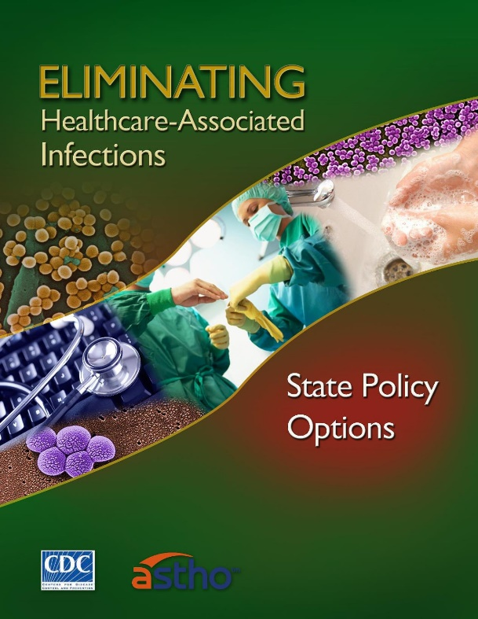
“Healthcare-associated Infections…also includes occupational infections among staff.”¹ (W.H.O.)
Sharps injuries are “HAI” – need tap into HAI resources
35 states mandate HAI be recorded.³
27 states require HAI be publicly reported.³
Government pressure to reduce HAI²
1. WHO. Clean Care is Safer Care. Report on the Burden of Endemic Health Care-Associated Infection Worldwide.
WHO 2011 http://www.who.int/gpsc/country_work/gpsc_ccisc_fact_sheet_en.pdf.
2. https://www.cdc.gov/hai/pdfs/toolkits/toolkit-HAI-POLICY-FINAL_01-2012.pdf.
3. HAI State Law Summary. http://hospitalinfection.org/resources/state-infection-laws/state-law-summary

Slide 20
Thank You!
Why not an equal push for staff safety?
A 7% decrease in 16 years is NOT acceptable!
We’ve got the tools & strategies to reduce SI…
We owe it to our colleagues.
Roar Louder!

